Slide 1
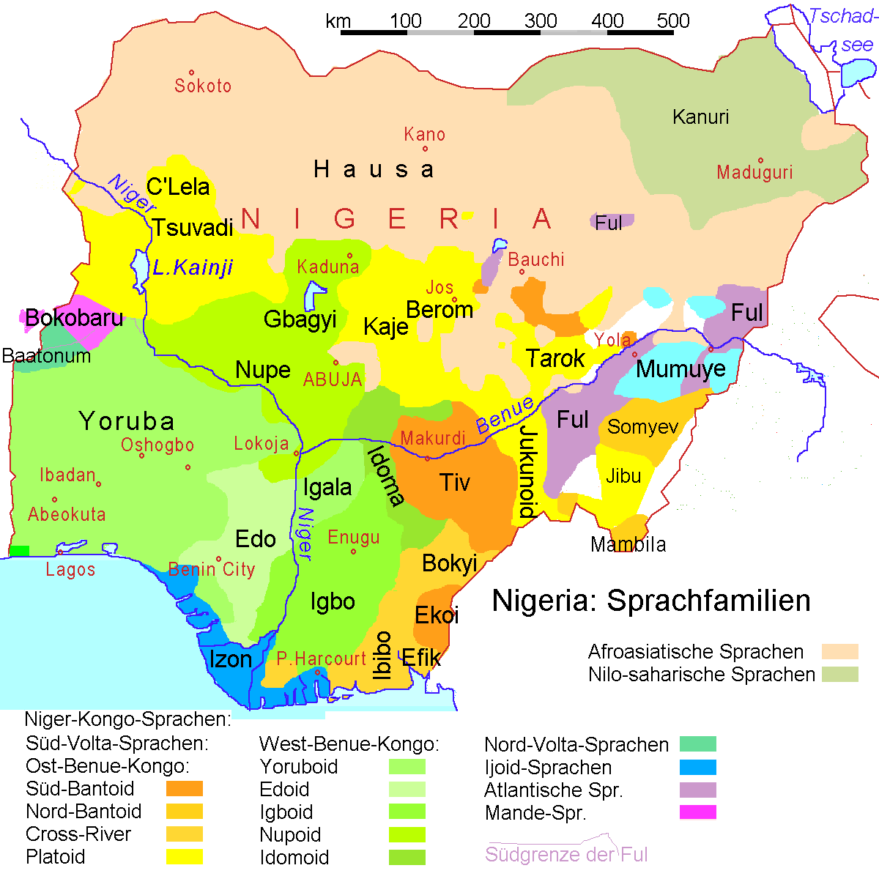
Von Ulamm - self-drawn, using data from Ethnologue, CC BY-SA 3.0, https://commons.wikimedia. org/w/index.php?curid=2979197

Slide 2
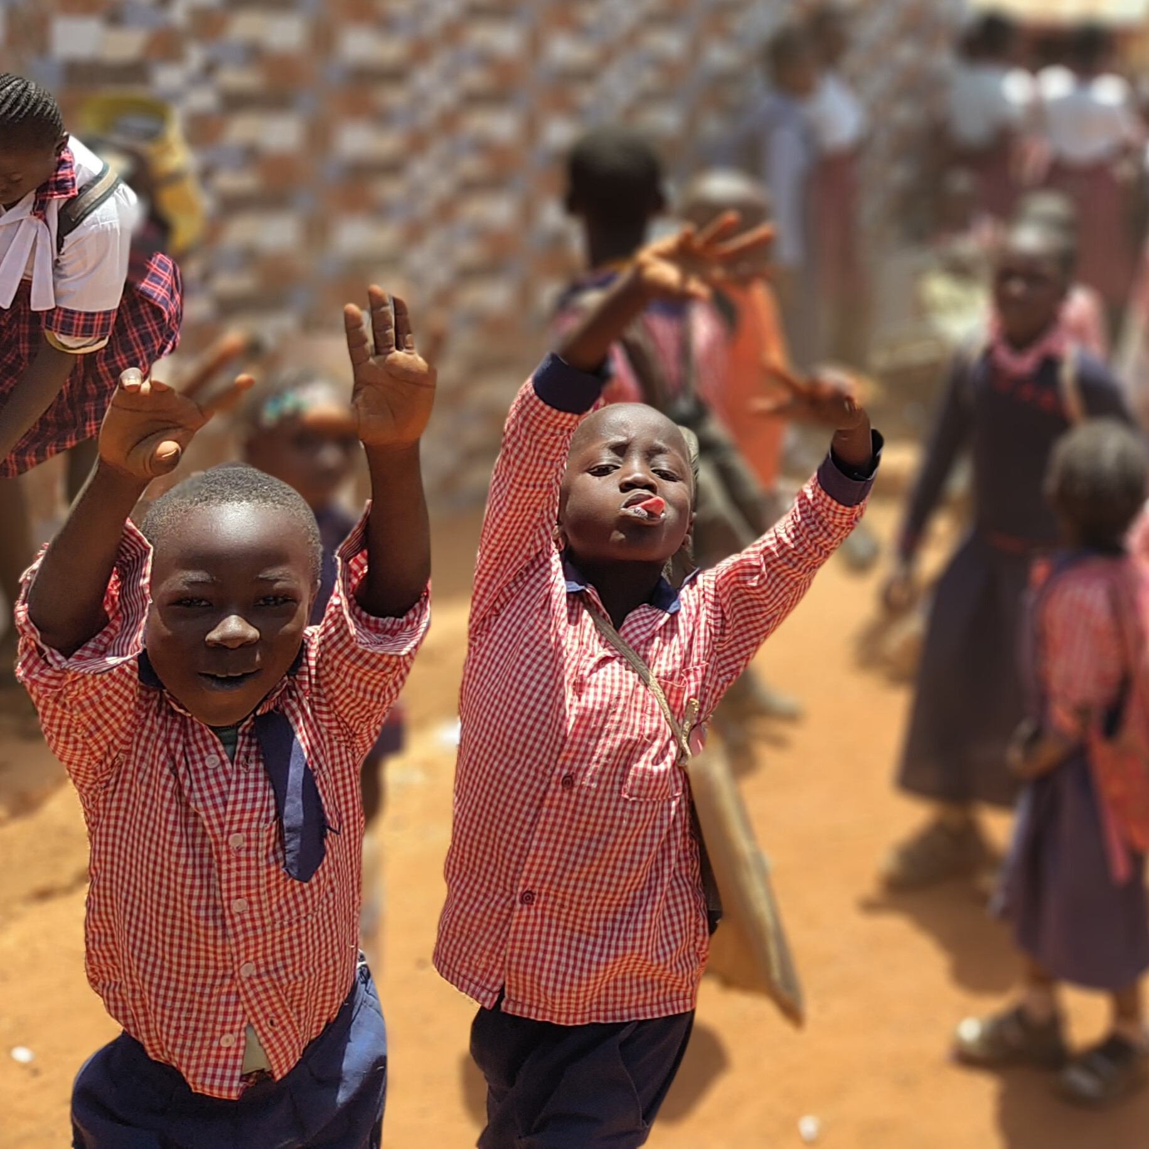
© EJW-Weltdienst, Kathrin Geiger

Slide 3
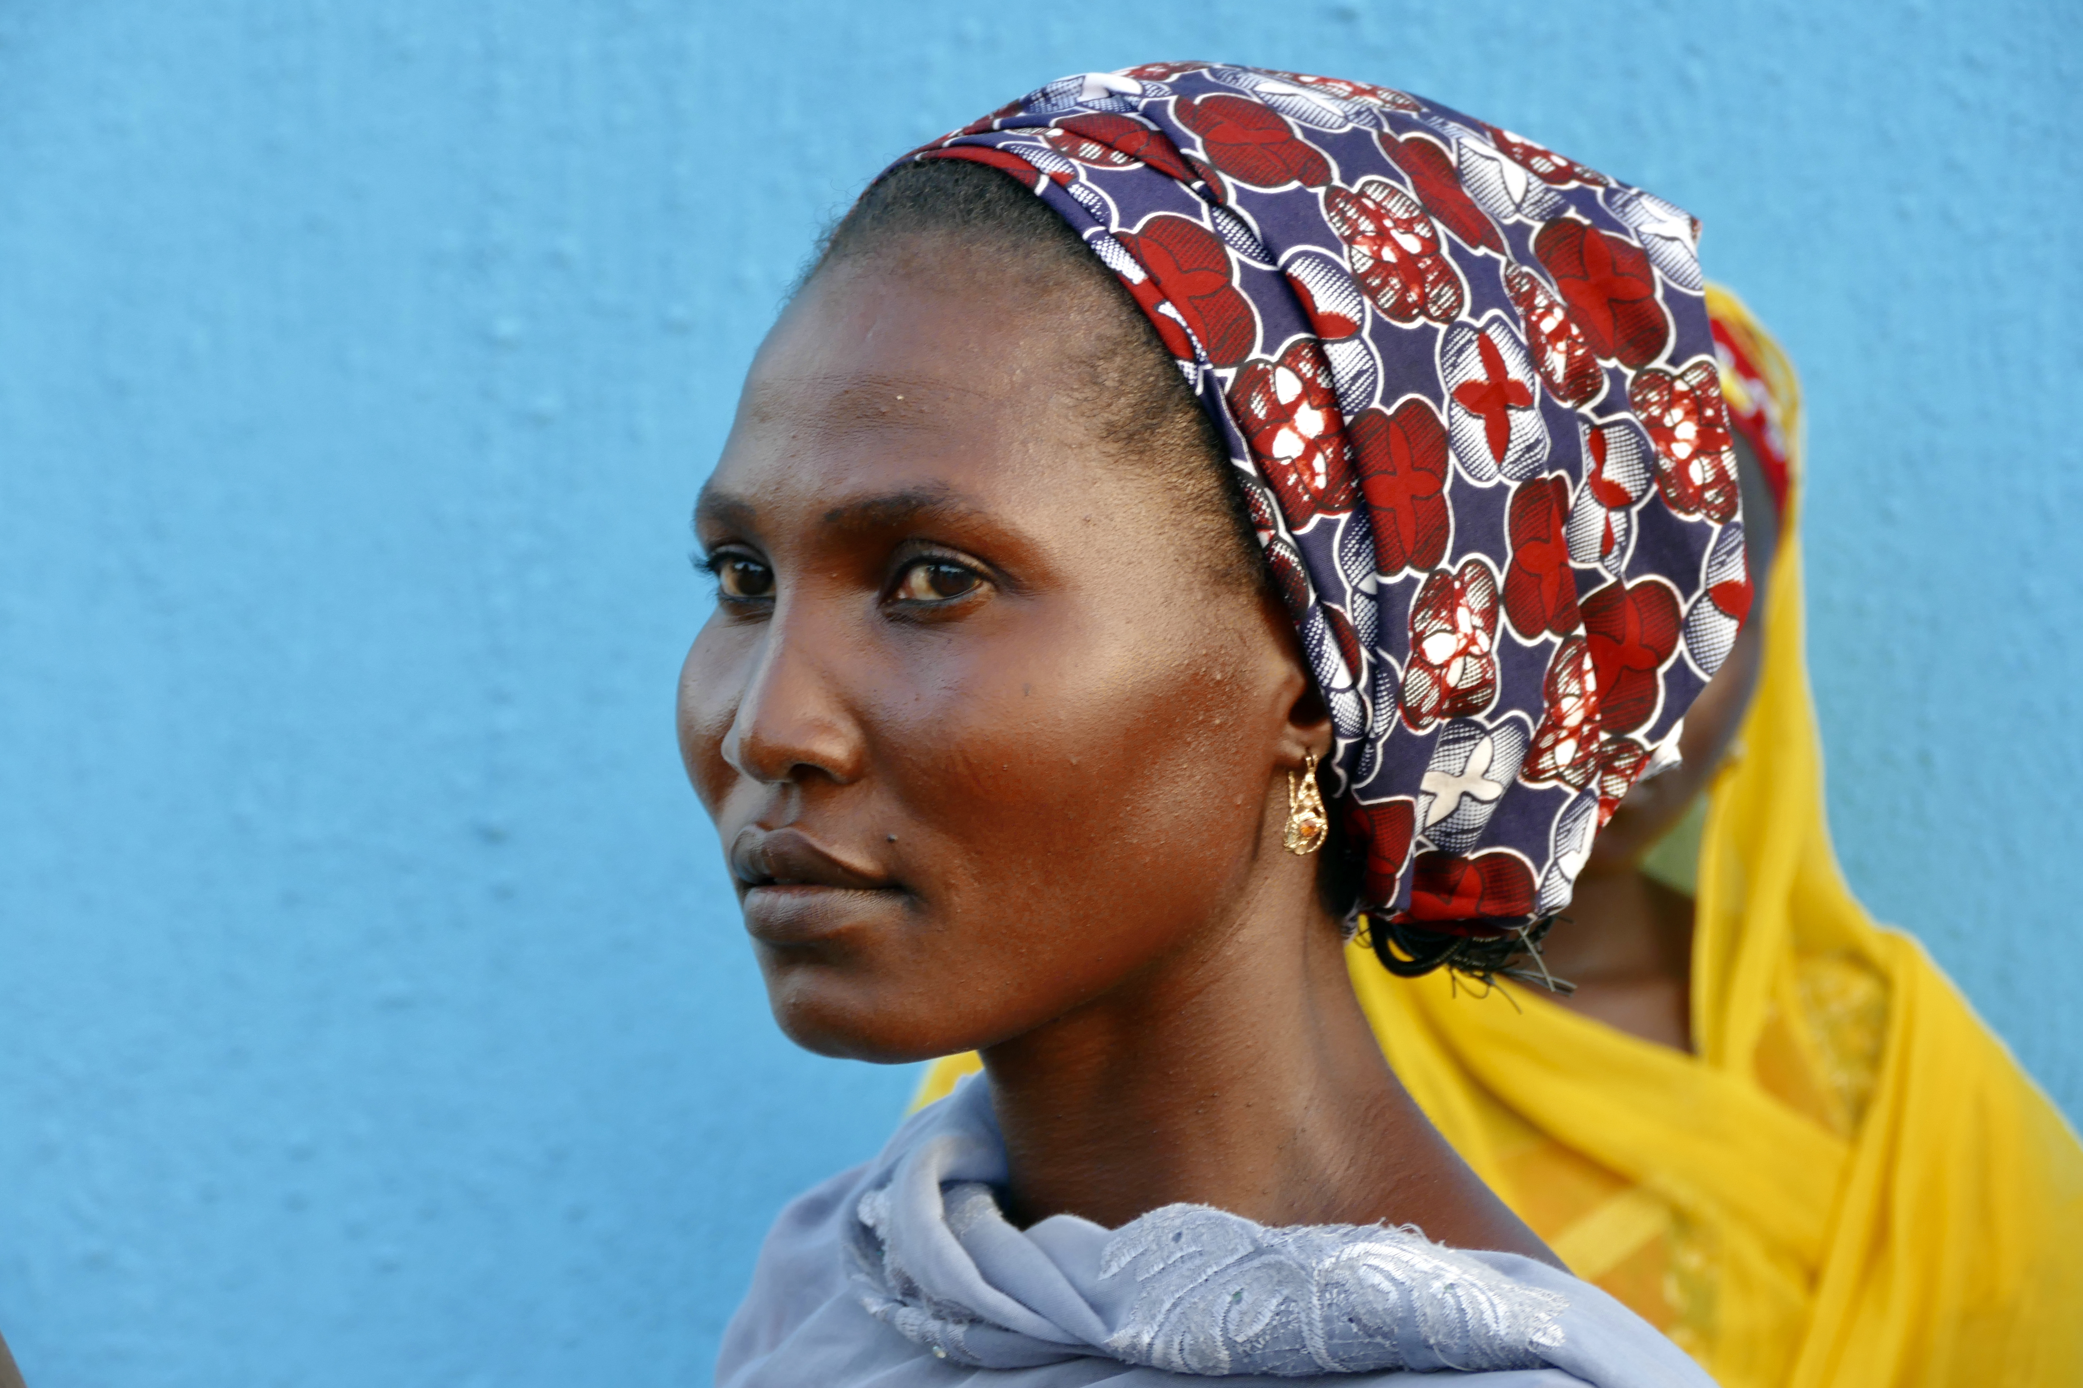
© Albrecht Ebertshäuser

Slide 4
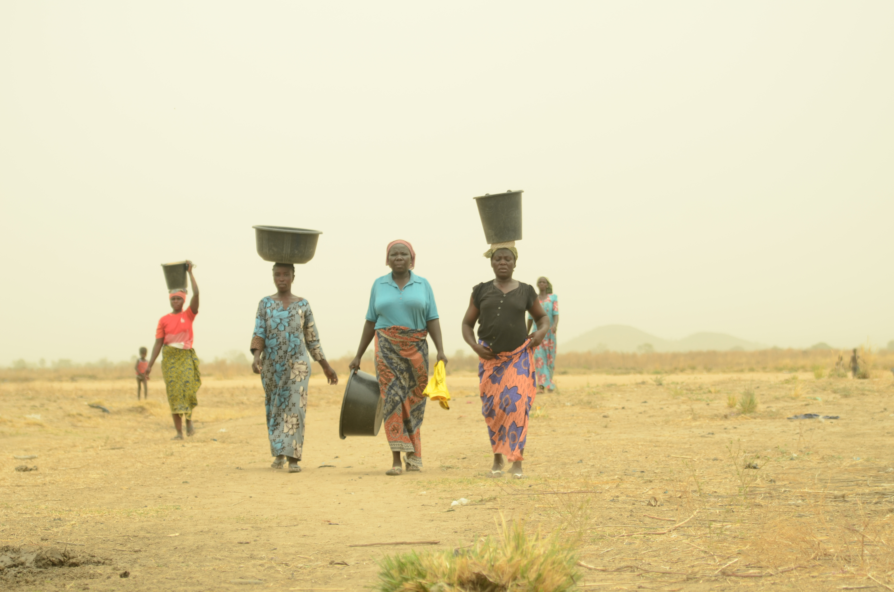
© Krojer/misereor

Slide 5
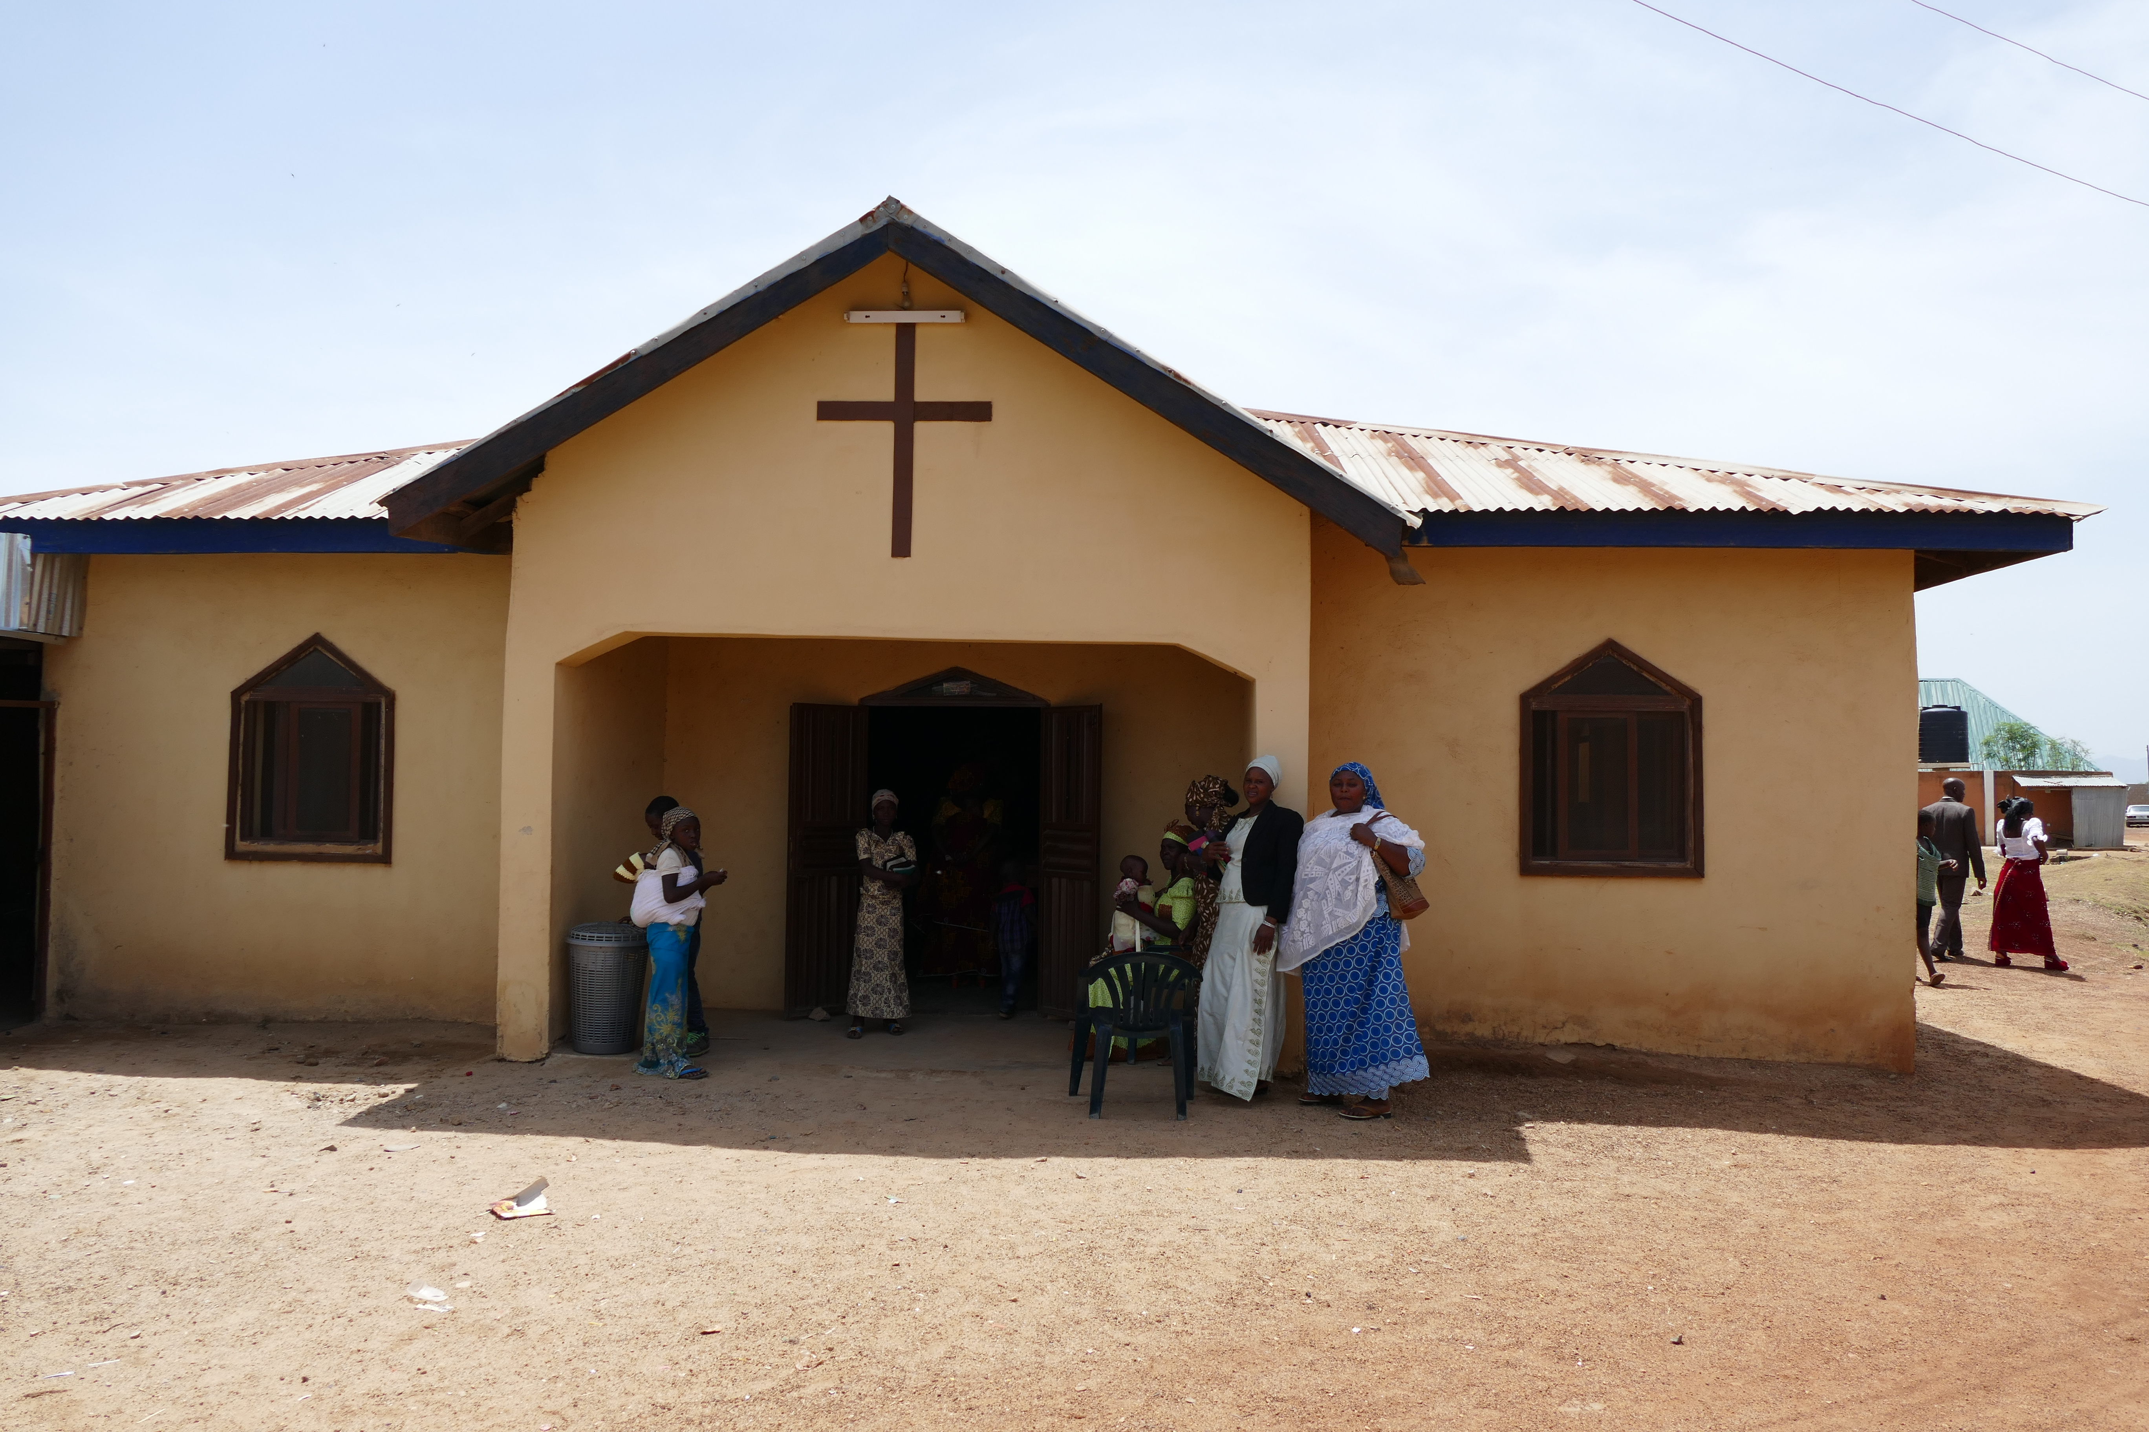
© Albrecht Ebertshäuser

